Slide 1
Survival Analysis of Heart Failure Patients using Machine Learning
Al-Mamun
191-15-2576
Riad Shalahin Leon
191- 15- 2613
Dr. S.M. Aminul Haque
Associate professor & Associate Head
Department of CSE
Daffodil International University

Slide 2
Table of Contents
Introduction
Motivation
Objectives
Methodology
Data Collection
Data Preprocessing
Outcome
References
‹#›

Slide 3
Introduction
Heart failure is the state in which muscles in the heart wall get fade and
enlarge, limiting heart pumping of blood. The ventricles of heart can
get inflexible and do not fill properly between beats.
The main reason behind heart failure include coronary heart disease,
diabetes, high blood pressure and other diseases like HIV, alcohol
abuse or cocaine, thyroid disorders, excess of vitamin E in body,
radiation or chemotherapy, etc.
‹#›

Slide 4
Motivation
Delay to take immediate treatment for the heart failure is one of the main reason for the high rate of death.
Proper treatment is key to get rid of from a disease .Most of the time a patient of heart disease is unable to get it .
‹#›

Slide 5
Objectives
To predict the patient heart condition immediately.
To reach timely appropriate treatment for patient.
Interpret the actual state of patient.
Using different types of machine learning algorithms to predict
patient situation.
Finding out the best algorithm for predicting patient Circumstance.
‹#›

Slide 6
Methodology
In our approach -
Step-1: Our dataset is chosen, which has Heart Failure Clinical Records.
Step-2: Who can live and who can't is classified in the dataset.
Step-3: To load the dataset, type in the data.
Step-4: Using ML algorithm python.
Step-5: Various machine learning algorithms are compared for their levels of accuracy.
Step-6: The Support Vector Machine(SVM) ensures the greatest precision.
Step-7: Calculate the performance of the model.
‹#›

Slide 7
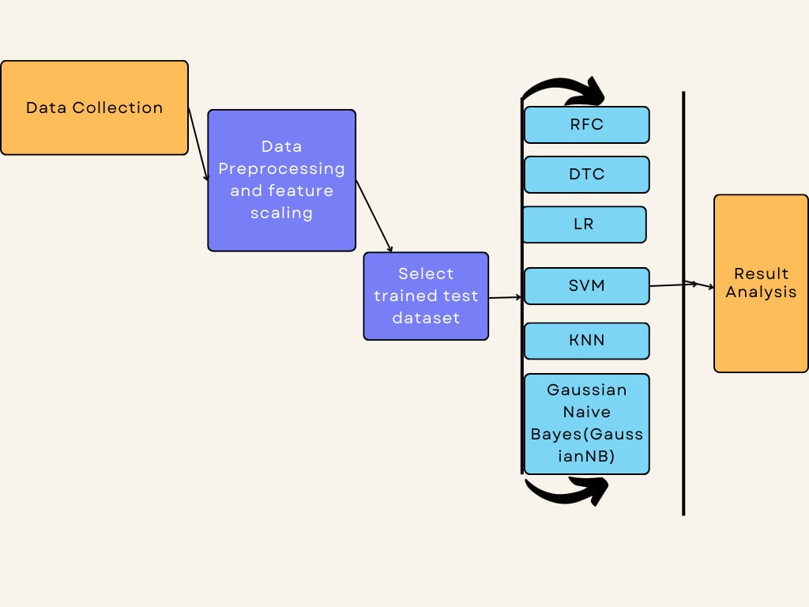
Building the Network
‹#›

Slide 8
Data Collection
Through Kaggle, we acquired this data collection. Making our analysis superior. A number of research publications were also examined; several of them focused on cardiac attacks. Our study examines the survivability of heart attacks that occur early specifically. Heart disease is on the rise right now. We aim to create a system that will help our people live longer by reducing heart disease deaths.
‹#›

Slide 9
Data Preprocessing
We compared predictions using an 80% model train and 20% testing sets and improved the overall predictive performance in comparison to previous methods.
‹#›

Slide 10
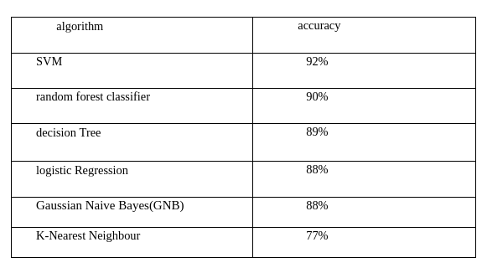
Outcome
‹#›

Slide 11
Reference
Effect of heart failure on the outcome of COVID-19 — A meta-analysis and systematic review Year published Accepted 3 July 2020
Rajkumar, A., & Reena, G. S. (2010). Diagnosis of heart disease using data mining algorithm. Global journal of computer science and technology, 10(10), 38-43.
HEART FAILURE PREDICTION USING MACHINE LEARNING TECHNIQUYear
published Accepted 29 Jan 2021
Wisaeng, K. (2014). Predict the diagnosis of heart disease using feature selection and the k-nearest neighbor algorithm. Applied Mathematical Sciences, 8(83), 4103-4113.
Enriko, I. K. A., Suryanegara, M., & Gunawan, D. (2016). Heart disease prediction system using k- Nearest neighbor algorithm with simplified patient's health parameters. Journal of Telecommunication, Electronic and Computer Engineering (JTEC), 8(12), 59-65.
‹#›

